Slide 1
The Intersection of Domestic Violence and Homelessness:
What to Look For and How to Help
Yoshi M. Bird, JD
Director of Programs & Grants
YWCA of Western Massachusetts
Notes:
Hi, everyone. My name is Yoshi Bird and I currently serve as the Director of Programs at the YWCA of Western Massachusetts. I previously served as Assistant Director over the homelessness services programs at the Center for Human Development, and as a result of my transition from the EA world to the DV (or domestic violence) world, I’ve developed a special interest in making sure that housing-unstable and homeless DV survivors have access to the full range of housing and homelessness resources available to them and that families in EA shelter have access to DV resources. I work with the rest of these fantastic people through the Subcommittee on EA and DV integration of the Western Massachusetts Network to End Homelessness. [Everyone introduces themselves]

Slide 2
Presentation Overview
What is domestic violence?
What does the population look like?
What are the red flags I should be aware of as a provider?
How should I handle it?
What resources exist for
survivors who are at risk
of, experiencing, or exiting
homelessness?
Notes:
So, I assume we all have varying degrees of familiarity with domestic violence and how to address it, so I’m going to start this presentation with a quick introduction to DV/SA (or Domestic Violence/Sexual Assault) 101: What is domestic violence, and what does the population look like. I then want to specifically identify red flags that could come up for the providers here who work in the EA context or with providers who work for other non-DVSA agencies. We’ll then talk about the best way to handle that initial conversation – when you think the person you’re working with could have domestic violence involvement, or when someone discloses domestic violence to you. Finally, we’ll wrap up by reviewing all the resources that exist across multiple funding environments that can be helpful for survivors of domestic violence at all stages of housing instability and homelessness.

Slide 3
What is domestic violence?
National Coalition Against Domestic Violence:
“Domestic violence is the willful intimidation, physical assault, battery, sexual assault, and/or other abusive behavior as part of a systematic pattern of power and control perpetrated by one intimate partner against another.”
Notes:
So, first things first, let’s define domestic violence. According to the National Coalition Against Domestic Violence, a nationwide grassroots domestic violence advocacy and training body, “Domestic violence is the willful intimidation, physical assault, battery, sexual assault, and/or other abusive behavior as part of a systematic pattern of power and control perpetrated by one intimate partner against another.” There’s a lot to unpack in this definition, starting with the point that domestic violence takes on many forms, including but not limited to physical assault. In the next slide, we can take a look at other domains of abuse and control and specific tactics that are common to domestic violence relationships. But the part I want to really bring your attention to is the point that DV is a systematic pattern of power and control perpetrated in an intimate partnership or dating relationship. We’ll talk in a minute about what domestic violence is and isn’t, but for now it’s important to note that DV can be distinct from high-conflict relationships or co-dependent relationships in that there is a discernible and more or less consistent pattern of control by partner A over partner B, and that the violence occurs in predictable patterns, which we’ll define in a minute.

Slide 4
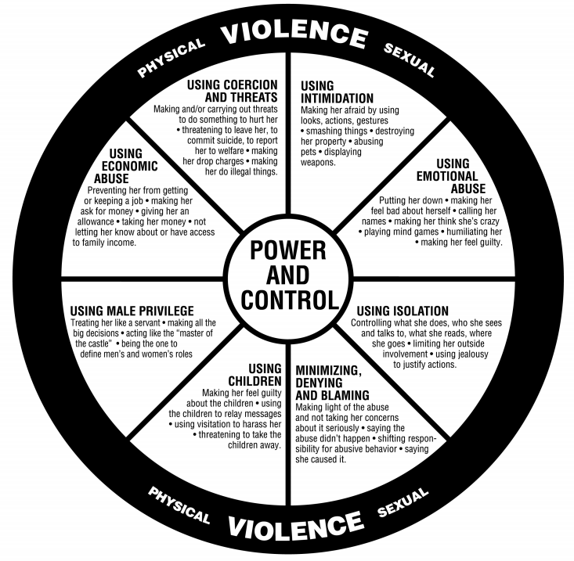
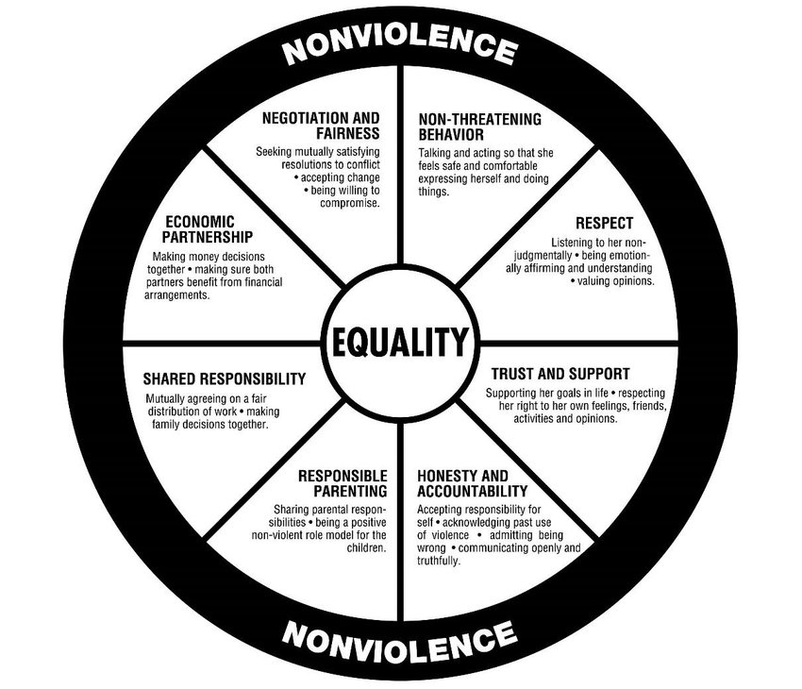
The power and control wheel
Notes:
The power and control wheel is, for DV and SA agencies, a very familiar illustration of the various domains of power and control that are common to DV relationships. This wheel was developed decades ago and has since been adapted to depict other related forms of institutionalized oppression in which one social group consistently exerts power and control over another. Physical violence alone would be difficult to sustain in a relationship without existing within a 360-degree environment that undermines the survivor’s belief in herself, in her worth, and in the legitimacy of her claims that she is, in fact, the victim of abuse. The manipulative and often-terrifying strategies used to assert power and control over the abused partner can keep her dependent on, or inextricably tied to, her abuser. Coercion, threats, intimidation, emotional abuse, name-calling, and abusive language – these aim to degrade, humiliate, gaslight, and knock a survivor off her game at all times so she believes that she either does not deserve anything better or that, even if she asks for help, no one will be able to help her. Economic abuse is extremely common, difficult to detect, and can threaten survivors’ ability to maintain compliance with EA and HomeBASE guidelines, as we’ll discuss. Finally, using children, isolating the victim, and asserting institutionalized privilege are also extremely common ways for abusers to trap survivors in what would otherwise be an untenable situation. I won’t have time to show all the great adaptations that have been developed for the Power and Control Wheel, but I highly recommend you google it. I did include in the presentation the Wheel of Equality – it’s always nice to see what a healthy relationships looks like!

Slide 5
What domestic violence is NOT
A high-conflict relationship is not necessarily domestic violence.
Domestic violence is not ONLY physical violence.
Domestic violence is NOT limited to heterosexual relationships, nor is it ONLY a women’s issue.
Domestic violence is not a private matter; it is a threat to individual safety and public health.
Domestic violence is generally not violence between family members who are not intimate partners (e.g., mother versus son).
Notes:
Now, clearly, domestic violence represents a complex pattern of abuse, and in some ways it looks different for every relationship. It’s important to note that conflict isn’t what defines a relationship as DV, and also that domestic violence isn’t always characterized by physical violence. (Most DV relationships in the early stages start out with the non-physical control and manipulation tactics and in fact may not involve physical violence at all right away) Although I use female pronouns to discuss DV as a shortcut, DV is not only a women’s issue, and it’s not limited to heterosexual, monogamous, or marital relationships. While many of us culturally may have grown up learning that a couple’s issues are a private matter and we should stay out of it, DV is not a private matter. It is a threat to the survivor’s safety and her children’s safety, and it is a significant threat to public health affecting survivors’ and children’s mortality rates, rates of serious injury, ability to participate in the workforce, ability to maintain housing, and other concerns. Finally, the resources I’m going to discuss are generally limited to violence between intimate partners people in an intimate relationship; while violence between neighbors or within other family relationships can also affect individual and public health, they may not qualify for many of the resources and supports we will identify.

Slide 6
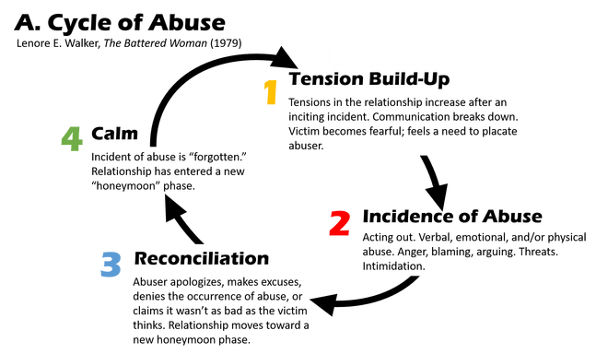
The cycle of abuse
Notes:
Another signal that a relationship could be domestic violence versus high-conflict or other relationship dynamics is a recognizable pattern of abuse that is more or less consistent across many DV relationships. The reason they are so common is that they are effective in establishing a survivor’s false sense of safety in between incidents of abuse and contribute to the destabilizing environment in which survivors begin to doubt their own experience – how can it be abuse? He apologized and did so much to try to make it up to me, etc. There are generally four stages to the Cycle of Abuse (depicted here) and for providers who work with a family long-term, you may begin to notice patterns in the family’s engagement with you or ability to remain compliant with program rules that could coincide with the stages of the cycle and flag for you that the family could have DV dynamics in the household.

Slide 7
Characteristics of DV survivors
Anyone can be a survivor!
Most resources are not tied to income, status, relationship, sexual identity, gender, or any other category.
Statistically, it is estimated that 16% of homeless persons are victims of domestic violence.
Approximately 50% of homeless women report that DV was the immediate cause of their homelessness.
Notes:
Statistically speaking, it is estimated that 16% of homeless persons are DV victims and that 50% of homeless women nationwide report that DV was the immediate cause of their homelessness. It’s important to know that anyone at all can be a survivor, not just our clients – there are undoubtedly survivors among us here today as providers, program managers, or agency executives. Thankfully, DV-specific resources often aren’t tied to income eligibility or other narrow categories, which helps the resources to meet the need of a population that cuts across all races, sexes, sexual orientation, gender identities, and socioeconomic statuses. The broad availability of resources to survivors in all sectors of society also responds to the reality that many DV survivors may appear on paper to have high income, but do not in actuality have the ability to safely access or control their own resources in addressing housing instability, fleeing domestic violence, or resolving homelessness.

Slide 8
Red flags for providers
A client has unexplained injuries, or a client’s explanation of injuries is difficult to believe.
One partner is generally silent during meetings while the other speaks “for” her.
A client is never allowed to meet with you without her partner present.
A client’s finances seem to be controlled by her partner, perhaps leading to arrearages.
A client or her child(ren) seem afraid of the client’s partner or explicitly report abuse.
Notes:
So here are some red flags to be on the lookout for as a provider. A lot of these scenarios might come up in your monthly meeting with a client who is living in EA shelter or during a HomeBASE stabilization check-in. For example, a client may show up with unexplained injuries, or her explanation of the injuries could seem unlikely or difficult to believe. If you work with an intact family or a couple, you might notice that one partner is generally silent during meetings or that one partner frequently or always speaks “for” the other. You might ask Partner A a series of questions, for example, and Partner B answers. If you notice that a client’s partner is present for every meeting, even meetings that might be routine or less critical, it might be a sign that the partner is not allowing your client to meet with anyone alone, because the client might disclose the abuse. If a client stops making her savings in EA shelter, or if she stops paying her portion of the rent because she’s giving money to her partner for expenses or without any explanation at all, it could be a situation of financial abuse. Be observant around a client’s body language and unspoken communication. If a client or her children seem afraid when they are meeting with you, when you ask them questions, or just when the other partner is in the room, it could be a sign of a DV relationship. And of course a client or her children can simply report abuse explicitly to you.

Slide 9
Red flags for providers
A client talks about what she is “allowed” or “not allowed” to do.
A client and her partner follow strict gender norms that leave the client financially dependent on her partner.
A client who otherwise follows shelter guidelines or Rehousing Plan begins demonstrating noncompliance due to a partner’s behavior, preferences, or needs.
Other providers express concern for the client’s relationship with her intimate partner.
Notes:
Another thing to pay attention to is the way a client expresses herself. Take note if she talks about what her partner “allows” her to do or does not allow her to do. Note if she talks about her partner being overly jealous, having a serious temper, or not allowing her to have male friends or speak to other men. Oftentimes, someone in an abusive relationship follows strict gender roles to their own detriment – for example, a woman may remain unemployed and care for children not because she planned for it and wanted it but because her partner believes that the man should be the breadwinner and the woman’s place is at home. A client who follows shelter guidelines or complies with her Rehousing Plan may start a new relationship and suddenly stop communicating with you, or she might start having problems with her landlord because her boyfriend is threatening the neighbors. She might suddenly quit her job even though employment was part of her stabilization plan because her partner tells her that he doesn’t want her to work or he shows up at work and creates a scene. Other providers in your client’s life may express concern that the relationship is causing problems or that one partner seems to be abusing the other. It’s important to know that you shouldn’t “sound the alarm” because any one of the red flags above could potentially signal DV, and you should NEVER confront a potential abuser with your suspicions; you can place a survivor in significant danger if you anger the abusive partner and threaten their absolute control over the survivor. In the next slides, we’ll discuss how best to help a survivor if you suspect DV or if he or she discloses DV to you directly.

Slide 10
“How can I help?”
If you can safely do so, speak with the survivor separately from her partner.
Let the survivor be in the driver’s seat! She knows best what is safest for her and what her abuser is capable of.
Stick to facts. Be neutral, nonjudgmental, and aware of your tone and body language.
Believe the survivor and support her in making the decisions that affect her own life.
Provide resources and support rather than your opinion. Keep the focus on the survivor.
Notes:
If you think a client may be in a DV relationship and if it is safe to do so, try to speak with the survivor separately from her partner. If you suspect that the partner would not allow this, do not push the issue. You don’t want to raise the abuser’s suspicions and endanger the survivor and her children. If the survivor is willing to talk to you, make sure she’s in the driver’s seat! You need to practice active listening, be neutral and nonjudgmental, and regulate your tone and body language so that she does not think that you are judging her for being in the relationship. The survivor lives with the abuser 24/7; you may only see him for an hour once a month. She knows best what the abuser is capable of and what is safest for her. Choose to believe the survivor and to support her in making the decisions that affect her own life; you don’t want to become another person trying to control her decisions, even if you are acting from a place of care and concern. The best way you can support the survivor is by providing her with resources and support, rather than directing her on what to do, placing mandates, enforcing compliance, or bringing the focus to your own opinion, your own life experiences, or, if applicable, your skepticism about her decisions or her story.

Slide 11
“How can I help?”
If the survivor cannot safely abide by shelter or EA/HomeBASE guidelines, seek support from your supervisor.
Best plan of action is referral.
Do not attempt to intervene in a violent incident yourself!
In a crisis, call the police.
Notes:
If the survivor cannot abide safely by shelter or HomeBASE guidelines, or if you’re having difficulty navigating a conversation with a client around DV, seek support from your supervisor. Supervisors, ALWAYS ALWAYS consult early and often with a DV or SA organization. You are not alone in handling these complex situations; we are thrilled to help. It is important to provide referrals to survivors, both to DVSA agencies and to DTA’s Domestic Violence Unit and other community resources that are DV-specific or available to DV populations. Most importantly, do NOT attempt to intervene in violence if it happens in front of you. In a crisis, call the police. With that said, be aware of the disparate impact that policing, incarceration, and child welfare agencies have had on people of color. Be mindful of your own evaluation of, and response to, crisis and know when police or DCF intervention is truly indicated.

Slide 12
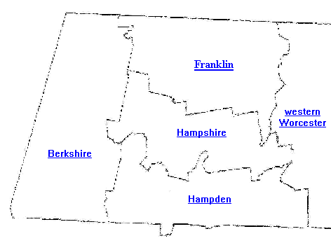
Resources for survivors
Notes:
Here I’ve depicted a number of DV and SA-specific organizations throughout western Massachusetts that receive funding from the Massachusetts Department of Public Health, the federal DOJ Office on Violence Against Women, and the Massachusetts Office of Victim Assistance to provide support to domestic violence survivors.

Slide 13
DV/SA resources for survivors
Emergency shelter
Community-based domestic violence services
24/7 hotline services
Rape crisis counseling and medical advocacy
Children’s programming
Supervised visitation
Services for communities experiencing inequities
Transitional housing
Permanent supportive housing
SAFEPLAN legal advocacy
Domestic Violence Intervention Project
Notes:
These are the specific DV and SA resources that are publicly funded and available unless otherwise indicated without cost to all survivors. I’ll try to point out some scenarios in which these resources would be relevant to clients of the EA family shelter and other homelessness systems.
Emergency shelter: Full residential services staffed 24/7 for survivors fleeing domestic violence or sexual assault. Must be in imminent danger of violence, must have no safe place to stay. No income requirements. HomeBASE eligible if EA-eligible. Emergency shelter might be a good option for a client in HomeBASE stabilization who is fleeing domestic violence and requires intensive support and heightened security in order to be safe, or it might be an option for someone who meets the requirements and is not EA-eligible, such as an individual survivor or a survivor who contacts your agency from out-of-state. Safe Passage, Elizabeth Freeman, Womanshelter, YWCA of Western MA
CBDV: Short-term 1:1 or group counseling that includes psychoeducation, safety planning, and emotional support. Non-clinical model. Free, open referral; however, we also have one group that is closed referral by DCF mandate. No requirement to be exiting relationship. These services might provide support to a family already in EA shelter or to someone receiving stabilization services. They can also help at the prevention stage if an individual is on the brink of homelessness, thinking of fleeing her current home, and/or needs support to identify a safe alternative to her current living situation. Elizabeth Freeman, NELCWIT, Safe Passage, WomanShelter, YWCA, BHN
Rape crisis: 24/7 medical advocacy response to local hospitals with SANE staffing. 24/7 sexual assault hotline. Short-term 1:1 counseling and psychoeducation. Non-clinical model. Free. If a client discloses sexual assault, within or outside the context of an intimate partnership, she can either access these services at the local hospital or by calling our 24/7 hotlines. Elizabeth Freeman, Center for Women & Community, NELCWIT, YWCA of Western MA (Hampden)
CEDV: Clinical therapeutic services for children who have witnessed domestic violence. Serves ages 3-18. Caretaker sessions available, as well as 1:1 or group therapy with children. YWCA offers TF-CBT, ARC models, as well as safety planning and 1:1 talk or play/art therapy. NO INSURANCE REQUIRED; no diagnosis. Referrals for long-term care if needed. These services can benefit both children who are actively witnessing violence in their home or after-the-fact, when a survivor has left her abuser and her children begin the process of healing. Elizabeth Freeman Center (Berkshire), Safe Passage (Northampton), YWCA of Western MA (Hampden County)
Supervised visitation services: Monitored on-site visitation, unsupervised visitation at secure site, or neutral exchange, where staff are present to facilitate exchange between residential and nonresidential parents of child in DV families. Open referral, though most referrals come through the court system. These services can help provide a safe way for survivors to facilitate their children’s visitation with the abusive parent; however, I recommend against referring a family yourself to supervised visitation due to the safety risks involved of identifying abuse to the abuser and the potential for abusers to use supervised visitation to manipulate and control survivors’ access to their children. If you think a family is a candidate for supervised visitation or it could benefit the family, you should call the hotline and confer with a DVSA agency’s staff. YWCA of Western Mass (Northampton and Springfield), NELCWIT (Greenfield)
Communities Experiencing Inequities: Specialized services tailored to the unique needs of underserved communities and communities disproportionately affected by domestic violence. Elizabeth Freeman Center (Berkshire), Safe Passage (Northampton), and Womanshelter/Companeras (Hampden)
Transitional Housing: Subsidized housing with case management support available for DV survivors. No requirement of imminent danger. Typically accessed by survivors leaving shelter who want to continue to receive support for up to two additional years while working toward economic self-sufficiency. Rent is required but subsidized through MRVP. This is a potential placement for DV-involved families exiting EA shelter who will need additional, ongoing support in order to stabilize, heal from DV, and achieve permanency. YWCA of Western Massachusetts
Permanent supportive housing: Permanent housing with supportive DV and case management services for small families with DV involvement and age-restricted head of households. This is another potential placement for DV-involved families exiting EA shelter but I believe has additional eligibility requirements around chronic homelessness status. Wayfinders Second Step
SAFEPLAN: Support, legal advocacy, safety planning, and technical assistance for survivors seeking restraining orders or navigating the legal system. Someone in shelter who is attempting to take their partner off the grant or to petition for custody of children in a DV scenario could access SAFEPLAN services to better understand the legal system, its inner workings, its benefits and risks. YWCA of Western Massachusetts (Hampshire District, Northampton Family & Probate, Westfield District, and Belchertown)
DVIP: 24/7 on-call integrated response to domestic violence incidents. This is available to your clients in the immediate aftermath of an incident once it is reported to the police and could be initiated for any survivor across any homelessness system. Partnership between the Police Department, DV agency, and DA’s office. Safe Passage, NELCWIT, Center for Women and Community

Slide 14
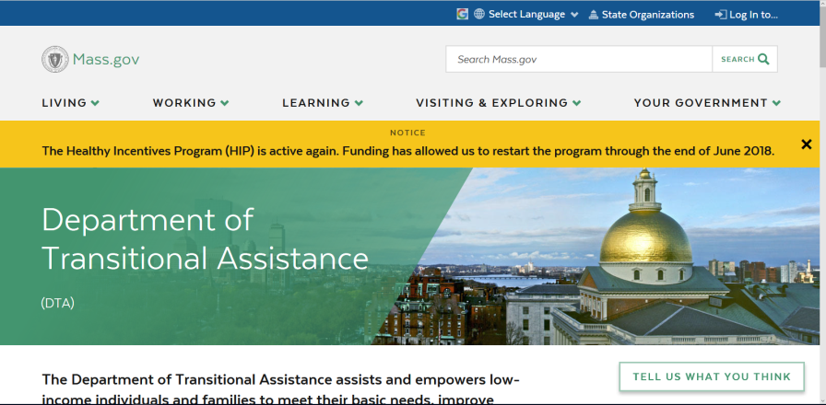
Other resources for survivors
Department of Transitional Assistance Domestic Violence Unit
Jane Lindfors (Springfield)
Miriam Chavez (Holyoke)
Legal services
CoC Rapid Rehousing funds
Emergency Assistance (EA) family shelter
Notes:
The Department of Transitional Assistance has specific resources and assistance available for DV survivors and can waive certain requirements for benefits due to safety considerations. Jane, did you want to take a moment to address the services available through your unit at DTA?
Legal services are available through multiple entities: Community Legal Aid, Probate and Family Court (file for divorce or custody), District Court (file for restraining order), Northwestern County District Attorney’s Office (prosecute specific incidents), Police Department, and Victim Witness Assistance.
Other resources are generally available to homeless households or individuals but are available for survivors as well as a result of their DV experience, such as Rapid Rehousing funds, EA shelter, and HomeBASE.

Slide 15
Referrals for abusive partners
Intimate Partner Abuse Education Programs
Supervised visitation programs
Notes:
Again, I advise strongly against discussing abuse with an abusive partner or referring that abusive partner to any program yourself because it poses a serious risk to the survivor and because abusers can sometimes manipulate these programs in order to maintain control over survivors. However, I want to bring these programs to your attention because, as providers, you can always communicate yourself with the agencies listed in order to understand their benefits and program specifications in the event a client is externally referred to one, and if you can have a safe conversation alone with a survivor, you would be able to answer questions she might have about existing resources for the abusive partner.

Slide 16
Best way to refer: Hotlines
(413) 586-5066
(413) 545-0800
(413) 772-0806
(866) 401-2425
Notes:
Now, how do I get in touch with all these amazing resources that are available to survivors, you might ask? There is a single point of access for all DV and SA referrals at each publicly-funded agency. In Hampshire County, Safe Passage is the provider of domestic violence supports and programming, while the Center for Women & Community provides rape crisis services during the academic year to UMass students and the surrounding communities. NELCWIT is in Greenfield and serves Franklin County. The Elizabeth Freeman Center is in Pittsfield and serves all of Berkshire County. These are their hotline numbers, which are their primary and best points of access.

Slide 17
Best way to refer: Hotlines
(413) 536-1628
(413) 733-7100
Notes:
In Hampden County, Womanshelter/Companeras serves primarily Holyoke, while the YWCA of Western Mass serves Springfield. These are our hotline numbers. Be aware that what I’ve said is generally true, but in some cases, the YWCA serves Hampshire County for certain services, while Safe Passage serves counties other than Hampshire for other services. If you’re not sure who oversees the service you’re looking to access, you can always call the agency closest to you and they’ll likely be able to point you in the right direction. Finally, the SafeLink statewide hotline can identify for a survivor all the available shelter beds across the Commonwealth of Massachusetts (in the event your local provider does not have space), as well as provide support and other resources and referrals as well.
Any questions?

