Slide 1
Subsidized Childcare April 30, 2019
Presented By:
Sara Garvin, NEFWC
Dawn DiStefano, Square One

Slide 2
Immediate Access to Childcare
DTA referral - if client is currently receiving cash assistance, or has received cash assistance in the last 12 months, s/he may be eligible for a Child Care Authorization from DTA (voucher only)
DCF referral – if client has DCF involvement in the home s/he may be eligible for a Supportive Child Care Authorization (voucher or contract)
DHCD or DCF Homeless referral – if client is currently residing s/he may be eligible for a DHCD or DCF childcare referral (contract only)
* There is no parent fee with most of these options*

Slide 3
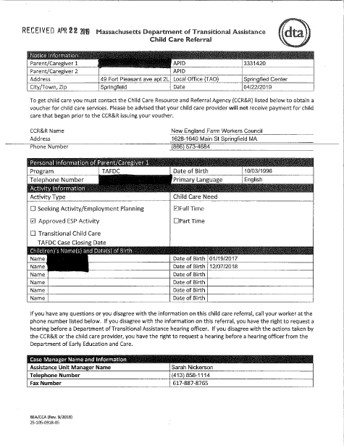
DTA Referral
Can be used for NEFWC vouchers
Can choose any home or center-based licensed provider that accepts vouchers
Client required to provide photo ID

Slide 4
DCF Referral
Issued in 12 month increments
If issued to NEFWC, client can choose any home or center-based licensed provider that accepts vouchers
If issued to a Contracted Provider can only be used with that provider
Client required to provide a photo ID

Slide 5
DCHD Referral
Per EEC - Awarded and Placed IE Contract Homeless Slots by Vendor (11/26/2018)
Vendor/Provider Name | Program Type | Slots Awarded
Berkshire County Head Start | Center-Based PreSchool | 3
Child Development and Education Inc. | QRIS FAMILY CHILD CARE < 2 | 2
Child Development and Education Inc. | QRIS FAMILY CHILD CARE > 2 | 3
Child Development and Education Inc. | System Family Child Care 2 yrs and Over | 10
Child Development and Education Inc. | System Family Child Care Under 2 yrs | 10
Holyoke, Chicopee, Springfield, Head Start, Inc | Center-Based PreSchool | 3
Holyoke, Chicopee, Springfield, Head Start, Inc | Center-Based Toddler | 1
Holyoke, Chicopee, Springfield, Head Start, Inc | QRIS CENTER BASED PRE-SCHOOL | 1
Square One | QRIS CENTER BASED TODDLER | 1
Square One | System Family Child Care 2 yrs and Over | 15
Square One | System Family Child Care Under 2 yrs | 10
Valley Opportunity Council, Inc. | Center-Based Infant | 1
Valley Opportunity Council, Inc. | Center-Based PreSchool | 5
Valley Opportunity Council, Inc. | Center-Based Toddler | 5
Valley Opportunity Council, Inc. | QRIS FAMILY CHILD CARE < 2 | 1
Valley Opportunity Council, Inc. | System Family Child Care 2 yrs and Over | 5
Valley Opportunity Council, Inc. | System Family Child Care Under 2 yrs | 4
Issued in 12 month increments
Can only be utilized at contracted providers who have been awarded DHCD contracted slots
Notes:
Insert DHCS Referral

Slide 6
Income Eligible (IE) Child Care
There are 2 ways to become eligible for an IE voucher:
Clients transitioning from DTA, DCF or DHCD authorized care are offered continuity of care and can be assessed as income eligible.
Receiving a “Funding Availability Letter” from the statewide waitlist (Kinderwait).

Slide 7
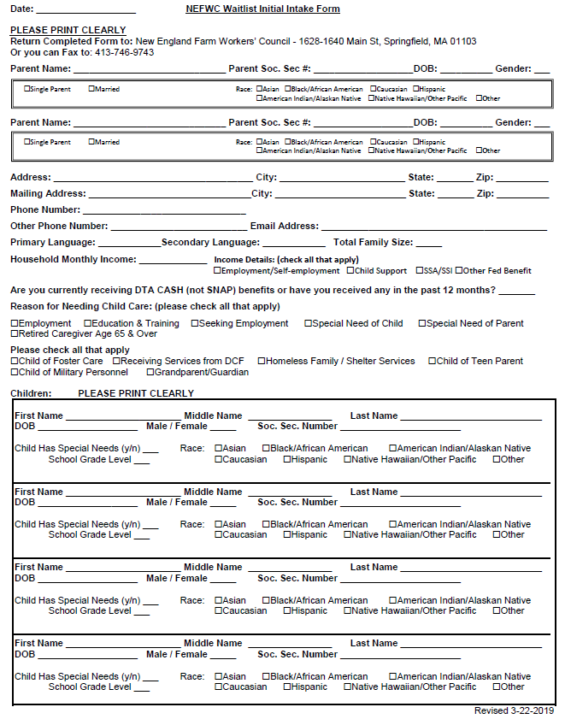
Kinderwait – statewide waitlist for income eligible childcare subsidy
There are three ways to be added to the waitlist:
1. complete and return the NEFWC Intake Form
2. call MASS 211 by dialing 211 from any Massachusetts’ area code
3. online registration at
http://mass211.org/child-care-wait-list-registration/

Slide 8
Kinderwait con’t.
There are currently over 2500 kids in Western MA active on the waitlist
It can be a 6-12 month wait on the list
Individuals on the waitlist are not assigned a number; funding opportunities are offered on a first come, first serve basis (by application date).
There are no priority populations
It is important that individuals on the waitlist update their information as needed and respond to any/all letters regarding the waitlist.

Slide 9
Kinderwait con’t.
There are 2 ways to receive a funding availability letter (FAL):
From NEFWC – if eligibility is established this funding can be utilized at any home or center-based licensed provider that accepts vouchers
(NEWFC’s most recent batch of funding letters went to families with 12/2017 application date)
From a Contracted Provider – if eligibility is established this funding is only good with the provider who issued the letter.
(funding opportunities vary by age and location
of open slot)

Slide 10
Contracted Providers in Western MA
Behavioral Health Network, Inc. | Child Development and Education, Inc. | Holyoke/Chicopee/Springfield Head Start
Belchertown Day School | Clarendon Family Daycare, Inc. | Kids Place
Berkshire Children and Families, Inc. | Community Action Pioneer Valley, Inc. | Kids Unlimited, Inc.
Berkshire County Head Start Child Development Prog., Inc. | Community Adolescent Resource/Care | Little Tots Day
Berkshire YMCA | Educare for Kids, Inc. | Marks Meadow After School Program, Inc.
Bethel Child Care Services, Inc. | Girls Club of Greenfield | Martin L. King Community Center
Boys & Girls Club Family Center, Inc./Springfield Girls Club Family Center, Inc. | Girls Incorporated of Holyoke | New North Citizens Council, Inc.
Boys and Girls Club of Greater Holyoke, Inc. | Gladys Allen Brigham Community Center | Springfield Partners for Community Action,.
Boys and Girls Club of Greater Westfield, Inc. | Hampshire/Franklin Day Care, Inc. | Square One/Springfield Day Nursery, Inc.
Chicopee Child Development | Holyoke Day Nursery | Valley Opportunity Council
Child Care of the Berkshires, Inc. | Holyoke YMCA, Inc. | Williamstown Community Preschool, Inc.
 |  | YMCA of Greater Springfield, Inc.

Slide 11
HOMELESSNESS as a service need
Under current policy families certified as
homeless may qualify for a
Child Care Subsidy
using a service need of homelessness.
A homeless service need does not guarantee
immediate access to a Child Care Subsidy,
unless the parent(s) meets the requirements for a
DHCD/DCF referral or EEC releases targeted funding.

Slide 12
Certification of Homelessness *per The Department of Early Education and Care (EEC) policy*
The following documentation is required to certify a family as homeless:
Homeless referral from DHCD
Homeless referral from DCF
A referral letter from a shelter program
Certification that family meets the criteria to be considered homeless under Subtitle VII-B of the McKinney-Vento Homelessness Assistance Act
*the Service Need of Homelessness is limited to two consecutive 12 month authorization periods*

Slide 13
A Referral Letter from a Shelter Program must include…
Date
Name of Shelter Agency
Shelter Type
Name and Contact Information of person making referral
Name and Dates of Birth of parent(s)
Name and Dates of Birth of all household members
Names and Dates of Birth of all children who need care

Slide 14
McKinney-Vento Homelessness
“means individuals who lack a fixed, regular, and adequate nighttime residence…”
Families will school aged children are certified through their child’s public school system
Families without school aged children are certified by the CCR&R agency

Slide 15
Enrollment Process
Center Based or Family Child Care
Call and Schedule Enrollment Appointment
Complete Application and Verification Paperwork
Provide Referral from DHCD or DCF (immediate access if contract available)
Provide Shelter Confirmation Letter or McKinney-Vento Approval Form (not immediate)
Authorizations – Two (2) consecutive 12-month periods for full time service

