Slide 1
Western Massachusetts Network to End Homelessness
Career Services Committee
Mission and Goals:
The Career Services Committee will work to create linkages to training and employment and related support services for individuals and families at risk of or experiencing homelessness.
It will create opportunities to collaborate and share information around available resources and best practices in furtherance of sustainable employment, increased income and greater housing stability for this population.

Slide 2
CAREER SERVICES WORKSHOP PRESENTERS
Massachusetts One Stop Career Centers
Pam Wojtkowski, BerkshireWorks
Bud Delphin, CareerPoint
Lisa Lapierre, Franklin Hampshire Career Center
Konrad Rugowski, FutureWorks, Springfield
Wayfinders Secure Jobs Program
Maegan Pedemonti
Department of Transitional Assistance Employment and Training Services
Kim Messeck

Slide 4
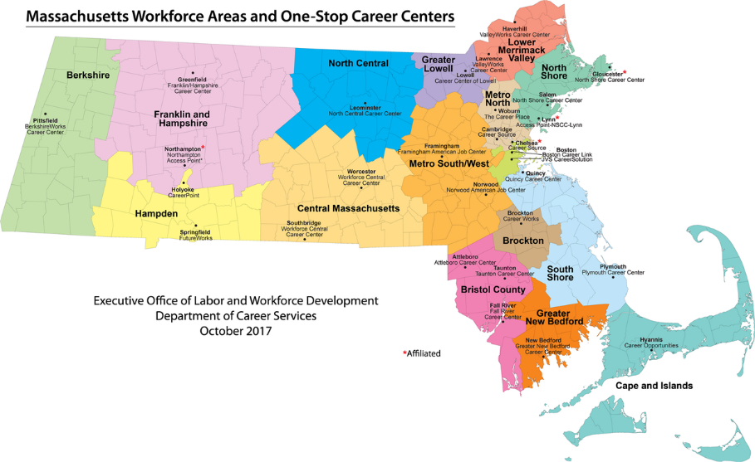

Slide 5
Western Massachusetts’ One Stop Career Centers
Notes:
Berkshire Works – Pittsfield
CareerPoint Holyoke
Franklin Hampshire – a full career center in Greenfield and Access points in Northampton at the Forbes library and in Orange at the Literacy Project
Future Works – Springfield

Slide 6
Accessing Career Center Services
BerkshireWorks, Pittsfield
Attend a Career Center Seminar – pre-registration required
CareerPoint, Holyoke
Attend a Career Center Seminar Orientation – pre-registration required
Franklin Hampshire Career Center, Greenfield (Northampton and Orange)
Stop by the Greenfield Career Center or call to learn about our services in Northampton and Orange
FutureWorks, Springfield
Drop in to a Welcome Meeting

Slide 7
General Career Center Services
Develop Job Search Tools
Resume Workshops and Individual Resume Critique/Consultations
Cover Letters Workshops
Interview Skills Workshops
Online Applications Workshops
Internet Job Search
Computer Workshops
Computer Basics/Intro to Computers/Word Basics/Excell
Resource Room
Computer, printer, fax, copier, phones
Career Assessment and Counseling
HiSET (GED)
Assessment, referral and or prep

Slide 8
General Career Center Services
Job Postings
Printed and/or online
Unemployment Assistance
Walk in assistance for Unemployment Claims
Job Fairs and Employer Recruitment
Referral to partner agencies including:
Adult Education
English for Speakers of Other Languages
DTA, Mass Rehab, Mass Commission for the Blind
Multi-Lingual Services
Migrant Seasonal Farm Worker

Slide 9
Career Center Programs serving Special Populations
Competitive Integrated Employment Services (CIES)
Intensive job search program for DTA cash recipients with barriers to employment
Offered at all Western Mass. Career Centers
Work Participant Program (WPP)
Job Search services for DTA cash or SNAP recipients who have limited barriers to employment
Offered at all career centers
Ticket To Work Program for SSI and SSDI Recipients
Career Counseling and Job Placement Assistance
Case Management and Pass Plan Counseling
Offered at all Western Mass. Career Centers

Slide 10
Career Center Programs serving Special Populations
Veterans Services
Veterans and Eligible Spouses receive Priority of Service
Offered at all career centers
Hurricane Evacuees from Puerto Rico and US Virgin Islands
May be eligible to receive English classes, Short Term Occupational Skills Classes, Supportive Services
Individualized job search, resume, application, interviewing skills and more
Trade Adjustment Assistance
Specialized services for workers who lost their jobs due to foreign trade
Offered at all career centers
Specialized Industry Specific Training Programs
Varies by region and available funding

Slide 11
Career Center Programs serving Youth
Workforce Innovation and Opportunity Act (WIOA) Youth Services
In-School and Out-of-School Youth ages 16-24
Offered in each region at the career center or through partner agencies
Young Parents Program (YPP)
Intensive HiSET prep program for DTA cash recipients up to age 24 who lack a high school diploma
Offered at CareerPoint and BerkshireWorks
Disability Employment Initiative (DEI VII)
Individualized job search program for youth ages 14-24
Offered at CareerPoint and FutureWorks

Slide 12
Career Center Programs serving Youth
Connecting Activities
In school career development education including job fairs, internships & more
Offered in each region through Regional Employment Board
Summer Jobs Programs
Eligibility requirements may differ in each community based on specific programs
Offered in each region
Work Readiness for Youth
Develop the tools needed to land a job
Offered in each region at the career center or through partner agencies

Slide 13
Workforce Innovation and Opportunity Act – WIOA Federally funded program for individuals re-entering the workforce
Career Counseling and Individualized Job Search Assistance
Training funding
Training funding may be available to:
Individuals who need training to obtain or retain employment that leads to self-sufficiency
Individuals who need training to obtain or retain employment that leads to wages comparable to previous employment
Funding amounts vary by region and are subject to availability
Each region serves eligible individuals who live in that specific region
Training must lead to a “marketable” credential, diploma or degree
Training options available at approved training vendors and schools

Slide 14
WIOA Eligibility
Disadvantaged Adult Program
Age 18 years of age or older
A US citizen or authorized to work in the United States
In compliance with the Selective Service Act
Meets low income eligibility standards
We assume that people receiving the following services are qualified:
Active DTA Cash or SNAP Recipients
Active SSI/SSDI Recipients
Documented Homeless Clients

Slide 15
WIOA Eligibility
Dislocated Worker
A US citizen or authorized to work in the United States
In compliance with the Selective Service Act
AND meets one of the following criteria
Has been terminated, laid off, or received notice of lay off
Eligible for or Exhausted Unemployment Insurance
Self employed with business closure due to economic conditions
Displaced Homemaker
Spouse of an active duty service member who was relocated

Slide 16
Secure Jobs Initiative
What is Secure Jobs?
Integration between non profit and public programs in employment, housing, child care, and education
Individualized Employment Supports
Goal planning, job search, resume, interview prep, cover letter, mock interviews
Flexible Funds
Skills trainings, child care, transportation assistance, textbooks, licensing
Job Placement
Access to Workforce Services
Wrap Around Support
Employment Specialist, Employer, Housing Worker
Job Retention Services
1 Year following first job placement

Slide 17
Secure Jobs Initiative
Who is eligible for Secure Jobs?
The person must meet Emergency Assistance (EA) requirements as established by the state:
Imminent risk of homelessness
Living in state funded EA shelter
Living in unit using HomeBASE funds and receiving Stabilization services
Receive RAFT funding to divert homelessness
Been diverted with Front Door funding and in HomeBASE
Be identified as a family, per state guidelines
Be READY, WILLING, & ABLE to participate in the program

Slide 18
Secure Jobs Initiative
Referral Process:
Electronic referrals made by housing workers
Accepted from agencies serving EA families’ housing needs & career centers
Emailed directly to Madeline Martinez: mmartinez@wayfindersma.org
What can the referring provider expect?
Quick intake
Proactive communication with Way Finders assigned Employment Specialist
Client progress, program updates, monthly calendars & events

